Slide 1
What Makes a Candidate goes Negative on Facebook: Case of US 2020 Presidential Election
Alan Nurcahyo

Slide 2
Research Question
How polling position affects the proportion of negative advertising in a online political campaign?

Slide 3
Research on what motivate a negative adsvertising
Skaperdas & Grof- man’s theory(1995) : The frontrunner will use more positive advertising in a two-candidate race, while the opponent will use more negative advertising.
Harrington er.al (1996) : candidate who has less attractive personal attributes runs a relatively more negative campaign.
Peterson and Djupe(2005) : Timing, number of candidate, incumbent status.
Backwell(2013) : Negative advertising is an effective strategy for nonincumbents.

Slide 4
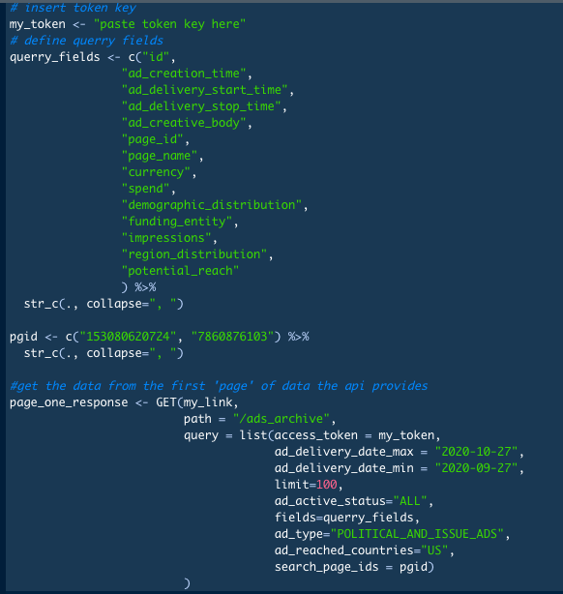
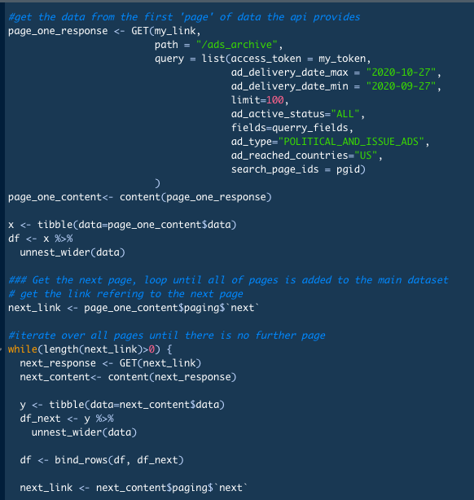
Advertisement from Facebook Ads Library API <httr,

Slide 5
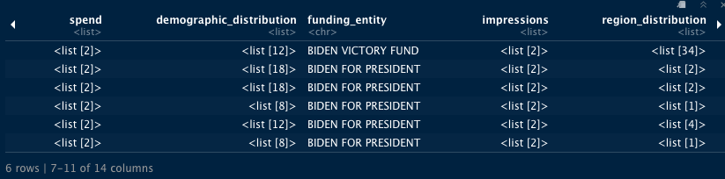
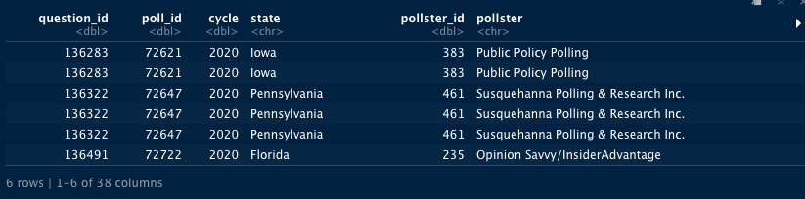
Datasets
Advertisement from Facebook Ads Library API <httr, tidyverse, lubridate> 172,726 obs unnested.
Presidential poll data from projects.fivethirtyeight.com< tidyverse, lubridate>

Slide 6
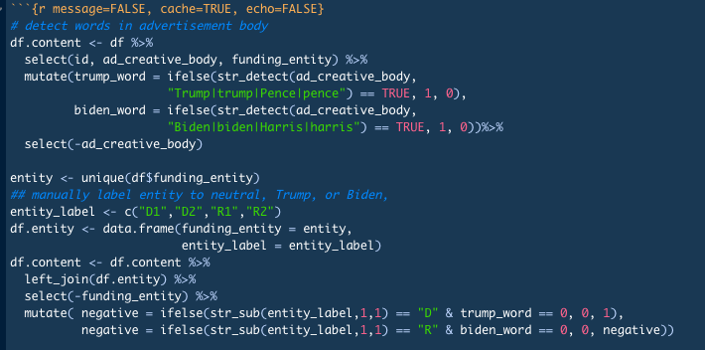
Defining negativity
Negative ads is ads that mention an opponent

Slide 7
Preprocessing
unnest_wider()
Lubridate function: month, days, parse_date() etc.
Join: left_join(), semi_join()
Stringer function: str_detect(), str_remove()
For loop .. Like a lot
Make train and test

Slide 8
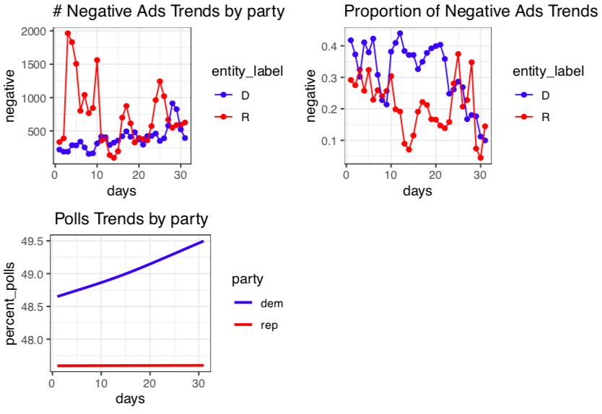
Exploratory Analysis (with train set)
* Negative ads is ads that mention an opponent
** data is aggregated in national level

Slide 9
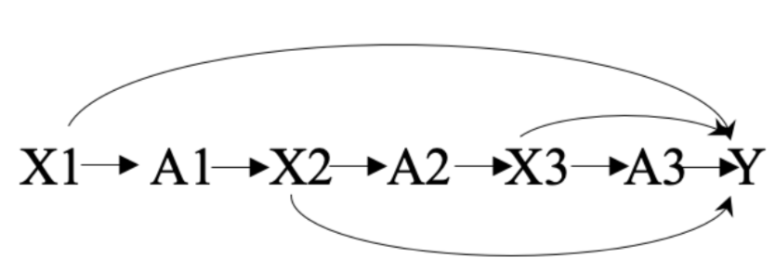
Dynamic approach on campaign strategy
** X is proportion of negative ads in week n
*** A is polls position by the end of the week n

Slide 10
Why Dynamic approach?
Reg <– lm(negative ~ polls_position, data)
Reg <– lm(negative ~ polls_position + factor(week), data)
Use IPTW to weight outcome based on polls position; with party and state as confounding, then use:
Reg <- svyglm(wt ~ nTx, data)
Where: wt is stabilized/unstabilized weighted outcome and nTx is cumulative number of leading/losing position

Slide 11
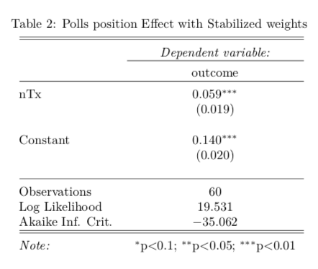
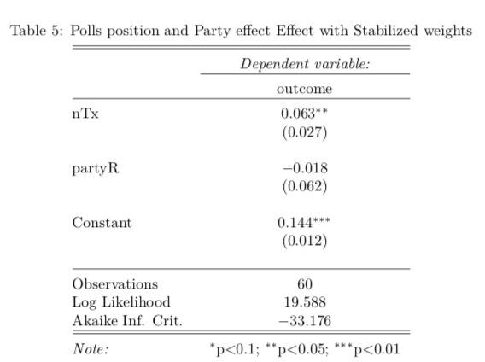
Confirmatory (with test)*
*R square: 0.2218725

Slide 12
Conclusion
Exploratory analysis using training set shows that there might be a relationship between polls position and negative advertising at the national level. at the start of the campaigning, democrat are inherently more negative than republican. However, as campaign goes on polls position favor a democrat, thus push republican to go more negative.
Confirmatory analysis finds that being in a trailing position, the candidate will go more negative.
Code, datasets, and paper: https://github.com/an4234a/appl.pol.data.science.paper

